Slide 1
Scikit-Learn Tutorials
By AI With Noor English

Slide 2
1
Lecture
In this video, we’re starting our Scikit-Learn tutorial series, and in this first lecture, we’re going to talk about something very important — Train-Test Split.

Slide 3

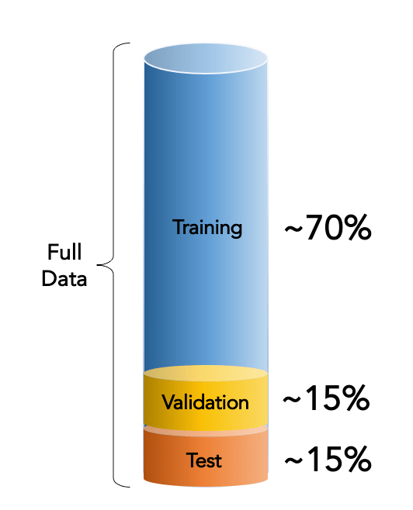
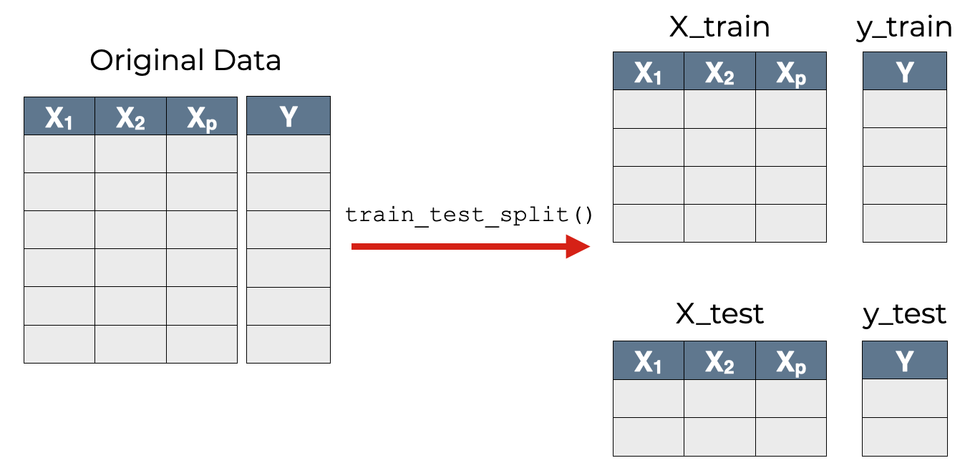
Train Test Split

